Slide 1
Producer Organisations
Key facts & findings
DG AGRI, Unit G1
Brussels, November 2019
Notes:
Except where indicated otherwise, all information is generally taken from the PO study.

Slide 2
Definition of producer organisations
POs can be defined as any entity that
  has been formed and is controlled by producers
  in a specific sector (horizontal cooperation)
  to pursue jointly one or more of the objectives
  listed in the CMO Regulation
  whether or not the entity is formally recognised
POs can take various legal forms, incl. cooperatives, associations, or private companies in which agricultural producers are shareholders
Notes:
Producer groups in post-2004 MSs and the ORs
FR, BE: Cooperatives d’Utilisation de Matériel Agricole
DE: Maschinenring
FR: Groupement Agricole d’Exploitation en Commun
DE: Erzeugergemeinschaft
HU: TSZ
IT: Reti d’Imprese
ES: Sociedades Agrarias de Transformación
FR: Société d’Intérêt Collectif Agricole
PT: Reciproco

Slide 3
Role of producer organisations
Regulation (EU) 1308/2013, ‘CMO Regulation’:
(131) Producer organisations and their associations can play useful roles in concentrating supply, in improving the marketing, planning and adjusting of production to demand, optimising production costs and stabilising producer prices, carrying out research, promoting best practices and providing technical assistance, managing by-products and risk management tools available to their members, thereby contributing to strengthening the position of producers in the food chain.

Slide 4
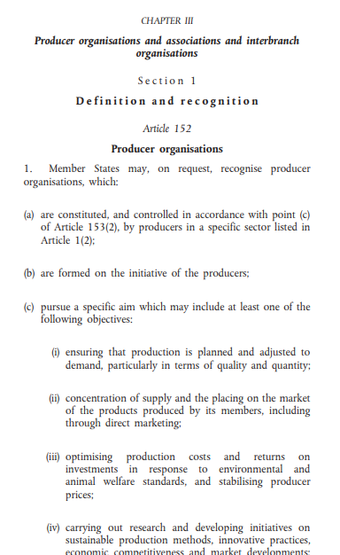
Recognition of producer organisations
The CMO Regulation (Art. 152) foresees the possibility for Member States (MSs) to recognise POs that
  are formed by producers
  follow democratic principles
  carry out joint activities
  pursue certain objectives
Certain recognised POs can receive
financial support through EU funds
(rural development, operational programmes)
Recognised POs can also benefit from certain derogations from EU competition rules
Notes:
The actual article (see image, which is already cut short) is much longer, i.e. the explanation here is not a legal one…

Slide 5
Classification of producer organisations
All POs
Recognised POs
Agricultural
cooperatives
Agricultural
cooperatives that
are recognised POs

Slide 6
Structure of the EU food supply chain
Farmers
10 million small and fragmented
agricultural holdings
A few large manufacturers generate
90 percent of the turnover
A few large food & drink retailers
dominate the market
500 million individual consumers
dispersed across 28 MSs
Gatekeepers
Consumers

Slide 7

Market power of farmers
Many small farmers individually face
few consolidated downstream operators
⓪①①⓪①⓪⓪①⓪①①⓪①⓪⓪①⓪①⓪①
①①⓪①⓪⓪①⓪①①⓪①⓪⓪①⓪①⓪①⓪
①⓪①⓪⓪①⓪①①⓪①⓪⓪①⓪①⓪①⓪①
⓪①⓪⓪①⓪①①⓪①⓪⓪①⓪①⓪①⓪①①
①⓪⓪①⓪①①⓪①⓪⓪①⓪①⓪①⓪①①⓪
①⓪⓪①

Slide 8
Greater market power of POs
Horizontal cooperation between farmers can help balance the economic asymmetry within the FSC
⓪①①⓪①⓪⓪①⓪①①⓪①⓪⓪①⓪①⓪①
①①⓪①⓪⓪①⓪①①⓪①⓪⓪①⓪①⓪①⓪
①⓪①⓪⓪①⓪①①⓪①⓪⓪①⓪①⓪①⓪①
⓪①⓪⓪①⓪①①⓪①⓪⓪①⓪①⓪①⓪①①
①⓪⓪①⓪①①⓪①⓪⓪①⓪①⓪①⓪①①⓪
①⓪⓪①

Slide 9

Benefits of farmer cooperation
Cooperation between farmers makes activities possible that can benefit them by generating added value that they could not achieve on their own, e.g.
  better market access (e.g. thru concentration of supply,
  joint marketing or distribution)
  greater contractual leverage vis-à-vis buyers of their products and suppliers of agricultural inputs
  more efficient production (e.g. through better access to
  technical knowledge, risk management mechanisms)

Slide 10


Wider benefits of farmer cooperation
Cooperation between farmers can also bring advantages to the rest of the food supply chain
Dealing with fewer POs instead of many farmers can help downstream operators reduce transaction costs:
  lower uncertainty for their long-term planning
  fewer business relationships
  and more stable prices
  more efficient organisation
  and delivery of supplies
  better quality assurance
  (specs, traceability, safety)

Slide 11
Competition rules prohibit cooperation
EU competition rules are laid down in the TFEU
(Treaty on the Functioning of the European Union):
  Art. 101 prohibits agreements between undertakings that affect trade or competition (e.g. price fixing)
  Art. 102 prohibits abuse of dominant market positions (e.g. to impose unfair trading conditions)
  >> Farmers who collaborate to obtain e.g. a stronger bargaining position could run afoul of these rules
Art. 42 allows legislators to limit the application of competition rules in the agricultural sector

Slide 12
Legal basis for farmer cooperation
The CMO Regulation (amended by the ‘Omnibus’ Regulation 2017/2393) details the derogations from competition rules in the agricultural sector:
  Art. 152 exempts recognised POs from certain competition rules (e.g. planning production, placing products on the market, negotiating supply contracts)
  Art. 209 exempts farmers, farmers’ associations and recognised POs from the prohibition of certain agree-ments e.g. on production or sale of agricultural products
  Art. 222 allows further derogations for recognised POs during periods of severe imbalance in markets

Slide 13
Number of recognised POs by MS
In 2017 there were >3,400 recognise POs in the EU (2018: >3,700), and 71 recogn. associations of POs
The MSs with most such entities were France (759), Germany (658), Spain (588) and Italy (563), followed by Poland (250), Greece (239) and Portugal (139)
In each of the other MSs there were fewer than 70 recognised entities (309 in total), and in Estonia, Lithuania and Luxembourg there were none at all

Slide 14
Frequency of POs across Member States
In 2017 the number of recognised entities per million holdings was 254 on average across the EU
In Germany there were 2,314 recognised entities per million holdings, followed by France (1,403), Czech Republic (1,397), Spain (585), and Belgium (490)
    This does not say anything about the effectiveness of the POs: In a MS with few but larger recognised entities, more farmers could be organised in such (stronger) POs than in a MS with many small ones
Notes:
Figure from “The contribution of producer organisations to an efficient agri-food supply chain”

Slide 15
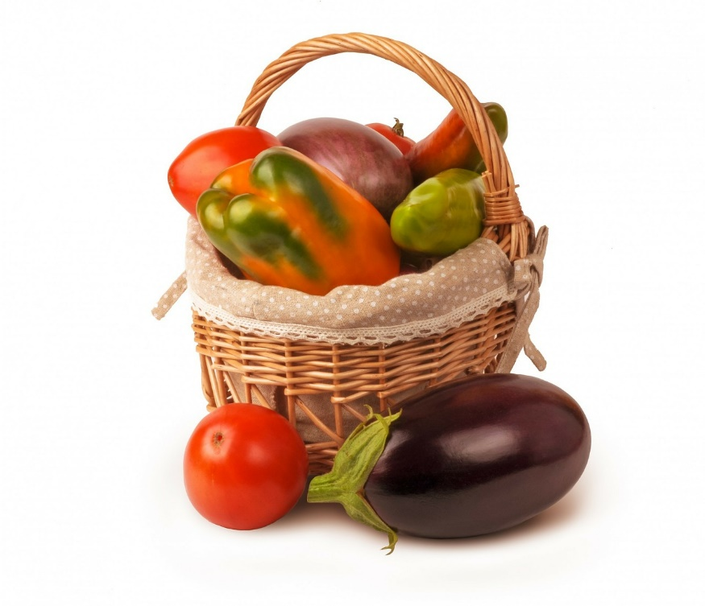
Numbers by sector & diversification
In 2017 the following numbers of entities were recognised in the various sectors:
1,851 (about half) in fruit & vegetables, 334 in dairy,
254 in olives, 222 in wine, 210 in beef, 177 in cereals, 101 in pig meat, 89 in sheep & goat meat,
and 267 in all other sectors
          POs in fruit & vegetables (F&V):
          77% market at least three crops,
          10% market two crops, and
          12% market only one
Notes:
(*) In Germany 33 POs were recognised in several sectors (mainly meat) and in several states; these cases are listed only once and only for the main sector.

Slide 16
New recognitions of POs over time
2018: >3,700 in total

Slide 17
Distribution of legal forms of POs
More than half of all recognised POs are cooperatives, but there are big differences across MSs

Slide 18
Size of recognised POs
In 2017 in F&V, only 6 percent (107 out of 1,659) of all recognised POs had a turnover over € 50 million, while 7 percent had a turnover below € 500k
Companies with a turnover up to € 50 million are considered small and medium-sized enterprises (SMEs) and those with a turnover up to € 2 million
are considered micro enterprises
  Most recognised POs are not bigger than SMEs and many would not even qualify as small enterprises
  But in Italy and France 10 and 9 entities, respectively, reported a turnover of more than € 100 million/year

Slide 19
Size of recognised POs
In terms of members, more than a third of recognised POs (38%) has fewer than 100 members, while most recognised POs (90%) have fewer than 1,000
Not directly comparable, but companies with less than 250 people count as SMEs, those with less than 50 as small enterprises (if also below the turnover ceilings)
  In Italy one quarter of POs has >2,000 members
>> Is there a crucial size for POs to be able to
strengthen the position of producers in the
food supply chain in a viable manner?

Slide 20
Multiple objectives of recognised POs
Notes:
Commission Delegated Regulation (EU) 2017/891, Article 11.1: The main activity of a producer organisation [in the F&V sector] shall relate to the concentration of supply and the placing on the market of the products of its members for which it is recognised.
Regulation (EU) No 1308/2013, Article 152.3: Member States shall recognise producer organisations, constituted by producers in the milk and milk products sector, which… (b) pursue a specific aim which may include one or more of the following objectives: (i) ensuring that production is planned and adjusted to demand, particularly in terms of quality and quantity; (ii) concentration of supply and the placing on the market of the products produced by its members; (iii) optimising production costs and stabilising producer prices.

Slide 21
Multiple activities of recognised POs

Slide 22
Marketing of F&V outside the PO
Distribution of F&V POs according to the share
of products they allow
their members to sell
outside the PO (legal
maximum is 25%,
40% for organic)

Slide 23
Role of non-recognised POs in the chain
According to stakeholders from POs, differentiating between recognised and non-recognised POs should not be central to an analysis of the structure of the food supply chain
When farmers decide to cooperate, they first choose a legal form for their organisation, and then they reflect whether or not they should seek recognition for it
Farmers do not create recognised POs, recognition
is simply one of several characteristics of a PO

Slide 24
Data on non-recognised POs
Data on non-recognised POs give a more complete picture of the degree of producer cooperation
They can also show to which degree POs take the additional step of obtaining recognition
Overall there are estimated more than 42,000 POs:
  more than half (22,000) are agricultural cooperatives
  the rest have other legal forms (incl. more than
  10,000 French equipment-sharing ‘CUMAs’)
Of these only 8.4 percent are recognised

Slide 25
Share of recognised POs (incl. coops)

Slide 26
Study of the best ways for POs …
… to be formed, carry out their activities and be supported:
Topics:
  Incentives and disincentives of farmers to join POs
  Performance of producer organisations
  Benefits of POs for their members
  Benefits of POs for other operators in the chain
Objective:
  Better understand how POs can be set up to attract members and carry out their activities effectively
  Better understand how POs can be supported
  Keeping in mind sometimes significant differences across POs, MSs and sectors

Slide 27
Data collection & geographic coverage

Slide 28
Assessing efficiencies generated…
… by agricultural producer organisations:
There exist no major differences in the performance of POs compared to investor-owned firms (IOFs), despite the fact that POs have to balance the needs of their members and their general corporate goals
Prices paid by POs can be higher than those paid by IOFs, and the more powerful POs are, the more they pay farmers, i.e. there can be a positive relationship between PO membership and farm income
POs in a market have a positive impact on its overall performance, and they often sell their products at lower prices than their competitors
Notes:
See references.

Slide 29
Higher concentration of supply
The share of producers in top production areas who are members of recognised POs is much higher than the corresponding national averages, e.g.:
  In France, 90 percent of tomato producers in Brittany are members of recognised POs, and 75 percent of apple producers in the South-West are, while the national average for the F&V sector is 50 percent
  In Poland, 40 percent of apple producers in Sandomierz and Grojecko-Warecki are members of recognised POs, while the national average is less than 15 percent
The concentration of supply through recognised POs is higher in top production areas than elsewhere

Slide 30
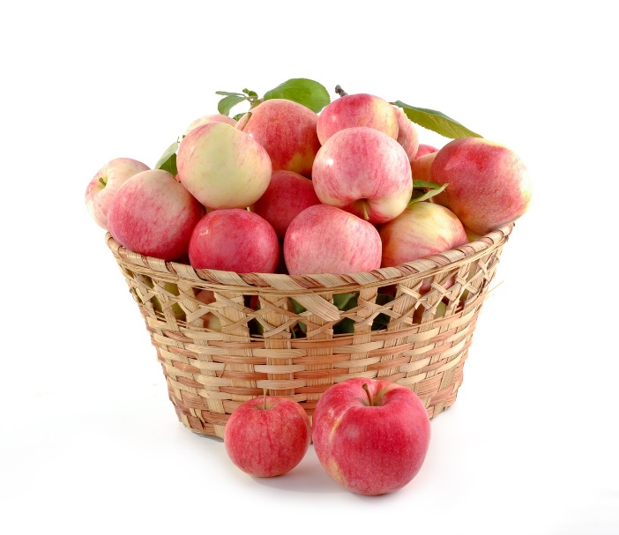
Prices paid by producer organisations
In the apple sector in Poland,
the price paid by POs
to their members is
on average 5 cents/kg
above the market price
In the pig meat sector in France,
the price paid by major POs
per live animal can be 180 EUR
above the reference price from auctions
Moreover, for individual farmers there are also costs linked to participating in auctions

Slide 31
‘Comfort’ of producer organisations
A main incentive for becoming member of a PO can have more to do with the ‘comfort’ and convenience that a PO brings, rather than the prices it pays
POs can be established to achieve wider objectives, going beyond financial performance to include development of social capital and member satisfaction
Independent producers in the vicinity of a PO see the need to differentiate their production by marketing product references (sizes, packaging, production approaches) that are different from the PO

Slide 32
Economic incentives (survey)

Slide 33
Economic incentives
Greater bargaining power through joint selling:
  lower transaction costs through larger volumes, marketing of baskets of complementary products, leaving fewer alternative suppliers for buyers
  better prices, long-term contracts, advance payments, etc.
Greater market knowledge of POs
(time and expertise to study markets and new products)
Greater market penetration through access to more profitable sales channels and new markets (requiring
a minimum scale of production or quality certifications)

Slide 34
Economic incentives
Shortening of supply chains (fewer intermediaries, better understanding of demand)
Better and more predictable prices (due to greater negotiation power, market knowledge and penetration, shorter supply chains)
Lower ex ante and ex post transaction costs
(e.g. searching buyers or dealing with buyer opportunism and unfair trading practices)
Less competitive pressure (given rules for the marketing of members’ products by the PO)

Slide 35
Economic incentives
POs can invest in joint activities or facilities that add more value (e.g. integration thru storage or processing)
Risk sharing and risk management through POs
(e.g. price pooling, insurance schemes, income stabilisation/mutual funds, joint investments)
Greater delivery and payment security
Crisis management (e.g. timing of sales,
market withdrawals)
Access to bank loans through the PO

Slide 36
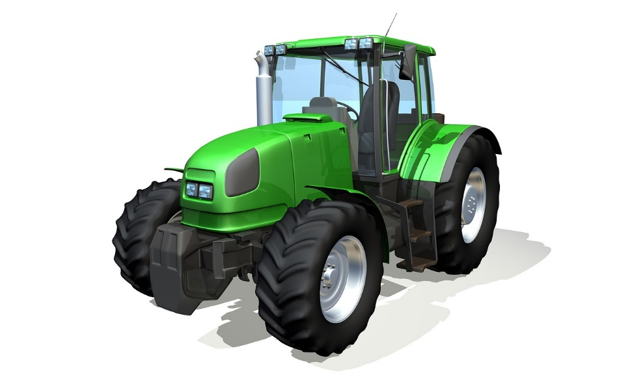
Economic incentives
Access to IP protected varieties for which a PO obtained the rights (e.g. Pink Lady)
Pre-financing of the purchase of inputs by members
              Joint procurement of inputs and machinery (e.g. lower prices, better delivery services, better payment terms, more informed purchasing decisions)

Slide 37
Other incentives
Economies of scale (shared machinery, storage, handling, processing, marketing, quality control, traceability, business intelligence, R&D)
Better inputs, machinery and related knowledge
Production planning (to prevent ‘overproduction’)
Technical support (for various standards & certification)
Sharing of knowledge and experiences between producers (on farming, markets, administration)
Reputation of POs as reliable business partners
Notes:
e.g. pig farmers in the survey attached more value to indirect economic benefits that POs can bring (namely the improvement or optimisation of the agricultural production methods at the level of individual holdings) rather than to higher prices

Slide 38
Other incentives
Degree of freedom to make own decisions compared to other forms of ‘collaboration’ (e.g. contract farming)
Democratic decision-making within POs
Social interactions within a community (the PO) and generation of social capital and trust
Strengthening the countryside and rural livelihoods (e.g. while POs help farmers, they are also employers)
Time saving (POs take care of non-production tasks)

Slide 39

Supporting the development of POs
The most efficient & profitable POs engage in vertical integration (adding greater value) based on horizontal cooperation of farmers (producing raw materials)
          Lack of capital to invest in value-adding activities can be an obstacle for some
          Investment support schemes can further cooperation between farmers and the development of POs

Slide 40

Disincentives for joining a PO
Based on interviews and the literature,
disincentives for joining a PO can be
sorted into three groups:
  economic disincentives
  regulatory disincentives
  social disincentives

Slide 41
Why don’t farmers join a PO? (survey)
Representatives of POs in the F&V and meat sectors:
Notes:
Unwillingness related to fear of loss of identity, autonomy and entrepreneurial freedom

Slide 42
Reasons for not joining a PO
Lack of information on benefits and models of POs (farmers do not know about the possibilities that POs offer nor about good examples of POs)
Orientation on perceived short-term benefits
(e.g. higher prices on spot markets)
Loss of entrepreneurial freedom, autonomy & control (esp. in bigger POs or in POs with exclusive sales rules)
Access costs (fees, operational and investment costs, compliance with PO requirements and standards, etc.)
Notes:
All based on the PO study

Slide 43
Reasons for not joining a PO
Potential conflicts between members (especially in more heterogeneous POs, with small vs big or young
vs old farmers who think differently about the future)
Satisfaction with existing sales channels and own reputation on the market (efficient markets, trustworthy partners, proximity to consumers)
Interest in keeping a low profile (vis-à-vis authorities)

Slide 44
Reasons for not joining a PO
Lack of administrative support by national authorities
Unfavourable tax systems for POs
‘Failure’ stories of POs (e.g. recognised POs that had to pay back subsidies after audits by the Commission)
Efficiency concerns (POs as one more intermediary)
Bad press and historic reasons (forced collectivism)
Subsidies reduces farmers’ need to cooperate

Slide 45
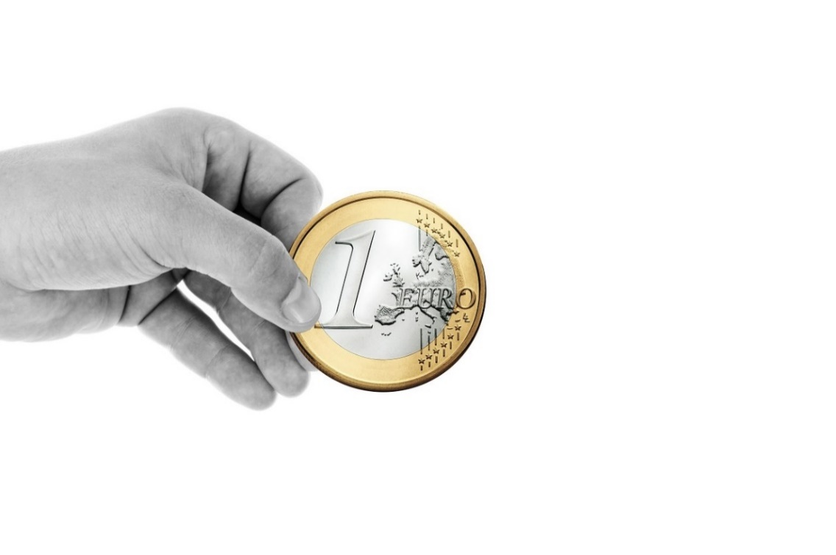
Reasons for seeking recognition as PO
Access to EU funding (operational programmes in F&V, support to set up new POs, esp. in ‘new’ MSs)
Visibility and reputation vis-à-vis other operators in the FSC and national authorities
Legal certainty and exemption from competition rules

Slide 46
Definition of ‘success’ of POs
The success of a PO can be defined in different terms: its longevity, business growth, profitability, or member satisfaction
Internal success factors for POs can be
  an organisational & governance structure that reflects the characteristics & needs of their members
  a homogeneous membership structure
  (similar production capacities and farm structures)
  a common vision that fosters shared beliefs and values within the PO

Slide 47
Internal success factors for POs
Internal success factors for POs can be
  an adequate size that allows realising economies of scale while keeping administration costs in check
  a competent and professional management
  sufficiently strong leadership that allows efficient information transmission and decision-making
  having a strategic plan for future growth
  (e.g. cost leadership, differentiation, innovation)
  resources to fund research & innovation projects

Slide 48

External success factors for POs
External success factors for POs can be:
  national history of agricultural cooperation
  collaborative partnerships with buyers
  cooperation among POs
  access to effective extension services
  conducive social relationships (trust)
  in rural areas

Slide 49
Benefits POs can offer other operators
POs can offer buyers a more stable and timely supply of agricultural products in required quantities and qualities from a single interlocutor
Sourcing from fewer suppliers helps buyers stabilise the prices they pay and reduces transaction costs
Bigger POs can better work with customers to adapt agricultural products to their requirements
POs can provide downstream operators greater assurance in terms of traceability, quality control, compliance with food safety standards, etc.

Slide 50
Benefits POs can offer other operators
Buying from POs whose members are linked to a specific rural area can help downstream operators meet consumer demand for local products
Some buyers prefer to deal with recognised POs, considering them to be particularly credible and trustworthy, given that they are subject to regular monitoring by competent authorities
Other farmers, who are not members of a PO, may receive better prices and conditions from their buyers to reduce their incentive to join a PO and keep the market more fragmented

Slide 51

Disadvantages for other operators
Dealing with POs can undermine
the bargaining power and
economic position of
downstream operators
(some of which prefer
entering into commercial
negotiations with individual
farmers to have more
leverage to impose their own
terms on supply deals)

Slide 52
Conclusions
In 2018 there were over 3,700 recognised POs
… and each year there are more
Most MSs have recognised POs (but EE, LT, LU)
FR, DE, ES and IT have most recognised entities
More than half of all recognised POs are in F&V…
and about half of all recognised POs are cooperatives
Plus, there are estimated 42,000 non-recognised POs

Slide 53
Conclusions
Key joint activities of POs are
  contractual negotiations
  commercialisation
  production planning
Main incentives for farmers to join POs are
  strengthening of members’ bargaining position
  provision of added value to member’s business
  (marketing, technical services, joint facilities, etc.)
  democratic decision-making & trustful cooperation
  those who do not join fear they would lose
  their identity and entrepreneurial freedom

Slide 54
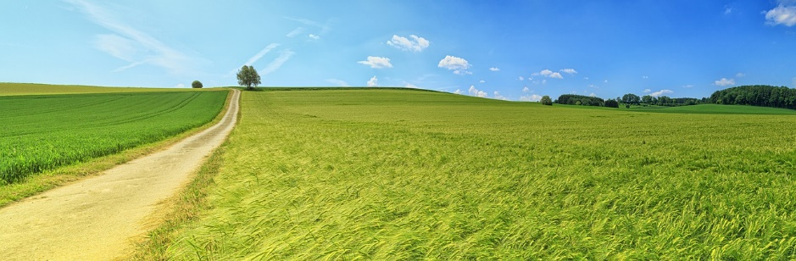
Conclusions
Conducive factors for the success of POs are
  a national tradition in agricultural cooperation
  good governance and effective decision-making
  a homogenous membership and joint vision
  financial support for the establishment of POs
  on the other hand, administrative requirements and strict audits can prevent POs from seeking recognition

Slide 55
Conclusions
Other operators benefit from POs, too:
  POs create direct and indirect employment opportunities
  They give more visibility to local products in general
  Downstream operators can secure more stable and timely supplies at lower transaction costs
    … even if POs can also weaken the bargaining power
    of other operators
  POs also provide better guarantees regarding the safety, quality and origin of the products they supply
  Recognised POs are seen as more credible & trustworthy

Slide 56
References
Study of the best ways for producer organisations to be formed, carry out their activities and be supported:
Summary: http://doi.org/10.2762/466335
Report: http://doi.org/10.2762/034412
Text annexes: http://doi.org/10.2762/81288
Data annex: http://doi.org/10.2906/097103114105/1
Regulation (EU) 1308/2013, CMO Regulation:
http://eur-lex.europa.eu/legal-content/EN/TXT/?uri=CELEX:32013R1308
Treaty on the Functioning of the European Union, TFEU:
https://eur-lex.europa.eu/legal-content/EN/TXT/?uri=CELEX:12012E/TXT
Regulation (EU) 2017/2393, Omnibus Regulation:
https://eur-lex.europa.eu/legal-content/EN/TXT/?uri=CELEX:32017R2393
Regulation (EU) 2017/891:
https://eur-lex.europa.eu/legal-content/EN/TXT/?uri=CELEX:32017R0891
Council Regulation (EC) 834/2007:
https://eur-lex.europa.eu/legal-content/EN/ALL/?uri=CELEX:32007R0834
Assessing efficiencies generated by agricultural producer organisations: http://doi.org/10.2763/76733
The contribution of producer organisations to an efficient agri-food supply chain:
https://ec.europa.eu/info/events/contribution-producer-organisations-efficient-agri-food-supply-chain-2018-sep-21_en
What is an SME: https://ec.europa.eu/growth/smes/business-friendly-environment/sme-definition_en
Images are generally free for commercial use with no attribution required,
taken from websites such as Pixabay: https://pixabay.com/

Slide 57
Further reading
Study on producer organisations and their activities in the olive oil, beef and veal and arable crops sectors:
http://ec.europa.eu/competition/publications/reports/kd0218732enn.pdf
The impact of producer organisations on farm performance:
http://doi.org/10.2760/463561
Fruit and vegetables producer organisations:
http://doi.org/10.2760/758545
Factors supporting the development of producer organizations and their impacts:
http://doi.org/10.2791/21346
Improving market outcomes: Enhancing the position of farmers in the supply chain:
https://ec.europa.eu/agriculture/sites/agriculture/files/agri-markets-task-force/improving-markets-outcomes_en.pdf
Assessing efficiencies generated by agricultural producer organisations:
http://doi.org/10.2763/76733
Support for farmers’ cooperatives:
https://ec.europa.eu/agriculture/sites/agriculture/files/external-studies/2012/support-farmers-coop/fulltext_en.pdf

Slide 58
AGRI-G1@ec.europa.eu

